Slide 1
North Shore Central School District Bond Referendum December 10, 2019
Dr. Peter Giarrizzo
Superintendent of Schools
November 13, 2019

Slide 2
Bond Question of the Week
Q. WHAT THE HECK DOES TAX NEUTRAL REALLY MEAN AND HOW CAN IT POSSIBLY BE THAT THE PROPOSED NORTH SHORE BOND IS TAX NEUTRAL?
A. The primary assumption made in planning this bond has been to achieve a payment schedule that remains flat from year to year. The bond payments from the 1999 Bond Referendum retired in the 2018-2019 fiscal year. In addition, two more bonds will retire in 2022-2023 and then again in 2025-2026. Our Board directed us to keep the projected principal and interest payments from this proposed bond AT or LESS than the amounts that are being retired. By doing so, the projected new annual bond payments will be at or less than all three of the retiring bonds combined.

Slide 3
A tax neutral plan
Retiring bond vs. new bond
Tax Impact 2019-20 Compared to 2020
Bond Principal & Interest for Home Valued at $750,000
Trustees directed the Administration to keep the projected principal and interest payments from the bond AT or LESS than the amounts being retired.

Slide 4
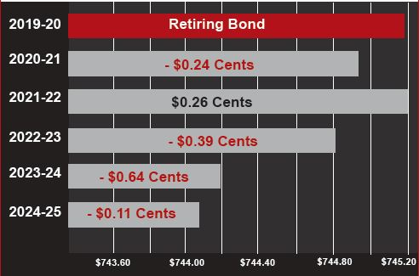
A tax neutral plan
Retiring bond vs. new bondS
Tax Impact – Five Year Projection 2019-25
Bond Principal & Interest for Home Valued at $750,000
In addition, the
Proposed Bond will
keep the projected new
annual bond payments
AT or LESS than all three retiring bonds combined.

Slide 5
2019 Bond Proposal
TOTAL BOND COST: $39,899,786
Category | Estimated Costs
Instructional Projects | $19,318,705
Infrastructure | $13,565,192
Health, Safety & Security | $4,014,787
Air Quality & Cooling | $2,709,547
Sitework
Trustees Proposes a Tax Neutral $39.89 Million Bond Designed to Have No Year-to-Year Increase in your Taxes
Sitework $291,555

Slide 6
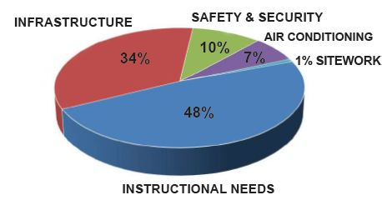
Bond Breakdown By Category

Slide 7
Bond Question of the Week
Q. WHAT ARE THE KEY INSTRUCTIONAL PROJECTS?
A. 21ST Century Learning Spaces are the key focus at all five North Shore Schools. Education today is vastly different than it was 20, 10, or even 5 years ago. Students now work and learn together with teachers acting as facilitators, instructing how to access, filter and use information. Today, learning spaces must allow and encourage all students no matter their learning style, to collaborate, communicate, create and think critically.
The next slides will highlight the specific bond projects at each of our schools.

Slide 8
Bond at a Glance
District-Wide Projects
School Specific Projects

Slide 9
Bond Question of the Week
Q. "I'm all for safety and security, Dr. G., but it is also so important to me that my child's school be accessible and welcoming. What are your plans to make this happen?"
A. This is such an important question and has always been at the forefront of our planning. The best security measures are noticeable without interfering with the general operations of the facility. We have set out to achieve that goal. Each school will have a secure entrance vestibule included in the primary design. They will be staffed by the existing security staff who not only greet our students upon entry but know them and their families by name. Those personal connections are what make our schools special and the objective of the secure entrance vestibule will be designed to vet visitors to our schools before they are given access.
We will also be building upon and expanding our existing video surveillance system enhancements, intrusion alarm and card access system upgrades, and door replacements across the District.

Slide 10
What happens if the bond doesn’t pass
Our goal has always been to keep budgeting flat to avoid spikes in budgets from one year to the next.
Options
Since the monies are already in the budget for principal and interest payments, the funds can be reallocated to offset costs of other projects.
If it is used to offset a future tax levy, the average home valued at $750,000 would see a one-time reduction of $130 in their school taxes.

Slide 11
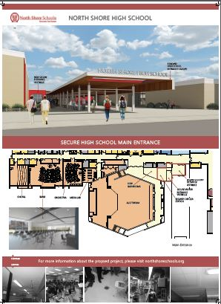
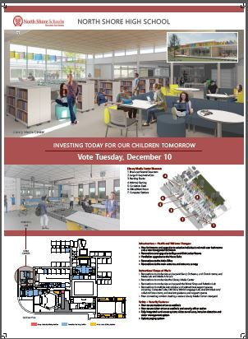
North shore High school

Slide 12
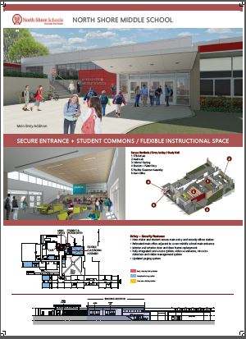
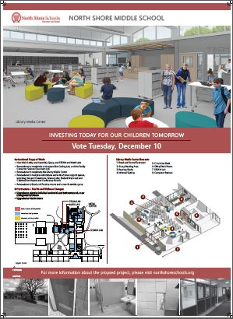
North shore Middle school

Slide 13
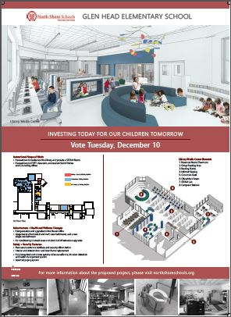
Glen head school

Slide 14
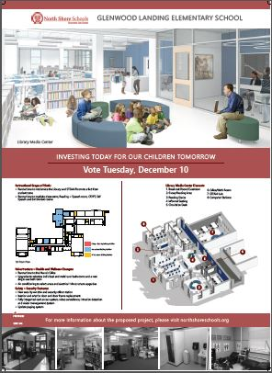
Glenwood landing school

Slide 15
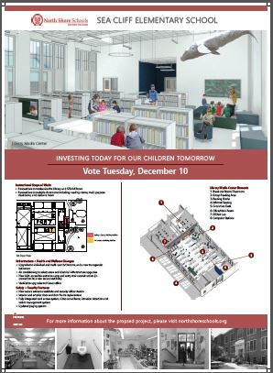
Sea cliff school

Slide 16
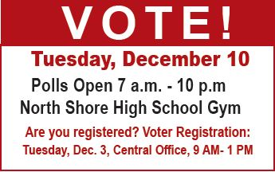
Remember to vote!

